Slide 1
A Method of Stock Price Prediction Based On News Title
Yudong Cao
Minghao Guo
Simin Liang
Jianuo Xu
Yunzhe Xu

Slide 2
Motivation
What we do:
Scrap news headlines and specific stock data from the Internet.
Make stock price forecasts base on the analysis of all information above.
Why it is interesting:
Stock price forecast is one of the most attractive and meaningful research questions in many areas.
Market news and the relationship between stock prices has widespread concern.

Slide 3
Do the prediction by web analysis
Some companies count the number of searching times on google and connect it with the stock price。
Some security companies analyze the tweets which related to the stock, find the emotion they expressed and divide it into six different emotions( such as silence, happy, attention and so on). They connect them with DJIA, and find the correlations between them.

Slide 4
Predicting the stock price.
the most concerned problem in finance
Moutai publish their financial statement
Ministry of commerce proved that tesla will build a factory in Shanghai

Slide 5
Previous work
GPC Fung based on the real time news. They use clustering and regression to segment the curve of the stock price. They get positive and negative features statistically. Then they predict the stock price.
TH Nguyen build a topic model that combine emotion and topics. Then, implement the model in predicting the stock feature. After getting the distribution vectors of the theme of each news, they combine the distribution into the feature of the stock price prediction.
Apart from the news, social medias are also used in the stock prediction. But these data are not suitable for the prediction for a single market.

Slide 6
Objective
Our objective is to propose a method for stock prediction.
Extract the features of technology stock-related news from several major news media.
Using several machine learning methodologies including SVM, decision tree and neural network.

Slide 7

Approach
Web Driver
http://www.seleniumhq.org/docs/03_webdriver.jsp
Beautifulsoup is unable to catch content from dynamic website, we use web driver instead.

Slide 8
How it works like

Slide 9
How it works like

Slide 10
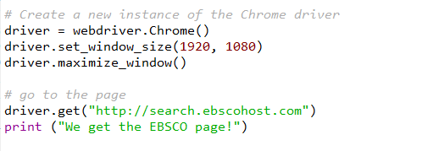
Web Driver Script

Slide 11
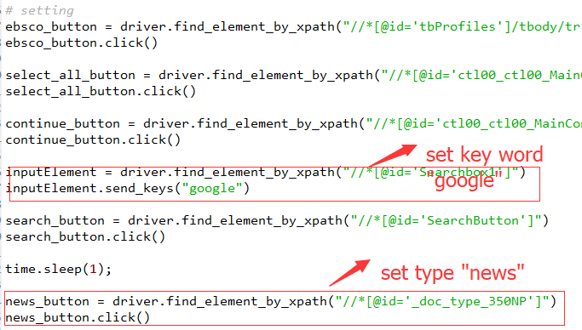
Web Driver Script

Slide 12
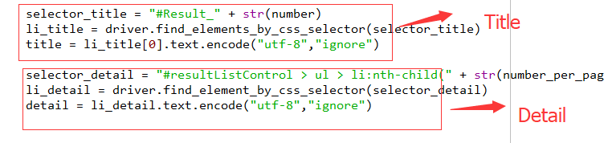
Web Driver Script

Slide 13
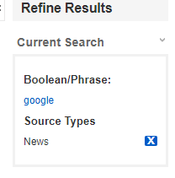
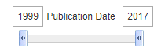
Data Sources
EBSCOhost Databases
http://search.ebscohost.com
Key word: google
Source Type: News
Publication Date: 1999 - 2017

Slide 14
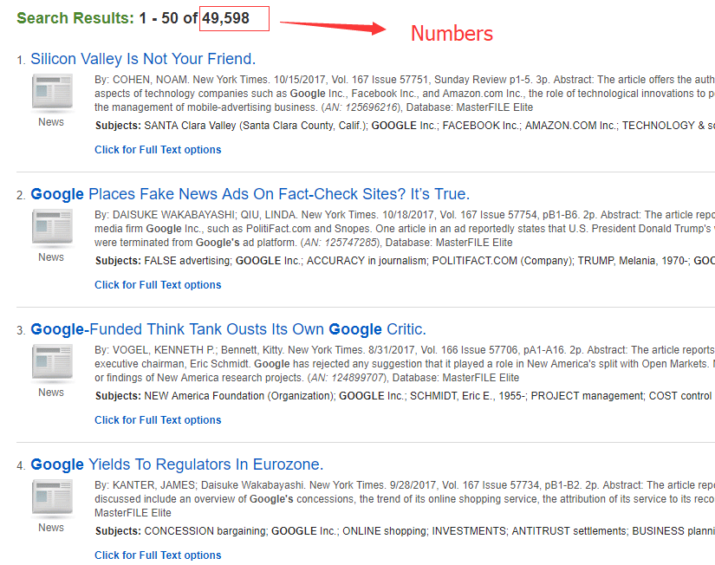
Search Result

Slide 15
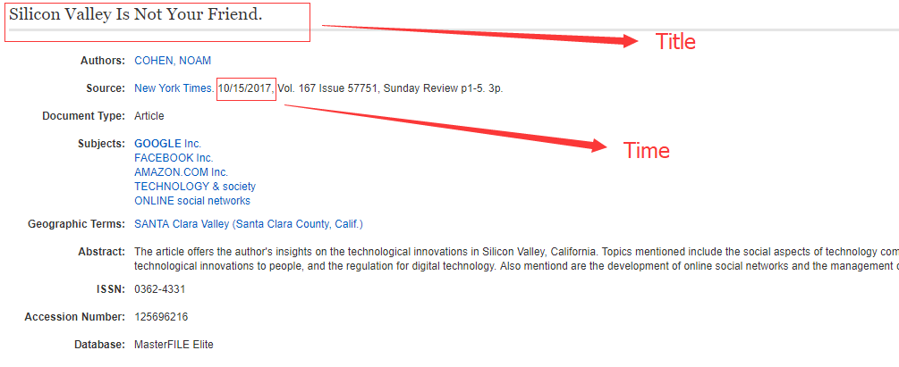
Data Structure

Slide 16
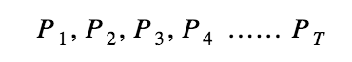
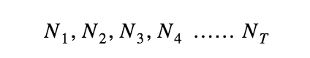
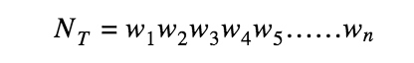
Methodology
Continuous price sequence
Continuous news title sequence

Slide 17
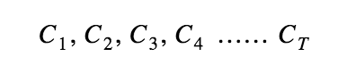
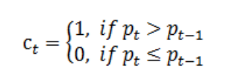
Methodology
Stock closing price in the daily goes ups or downs

Slide 18
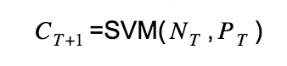
Methodology
2010 – 2014 Stock price and news titles
3000 news titles for each month/company
180,000 titles for each company
Use SVM or Decision tree or classification tree for pridiction

Slide 19
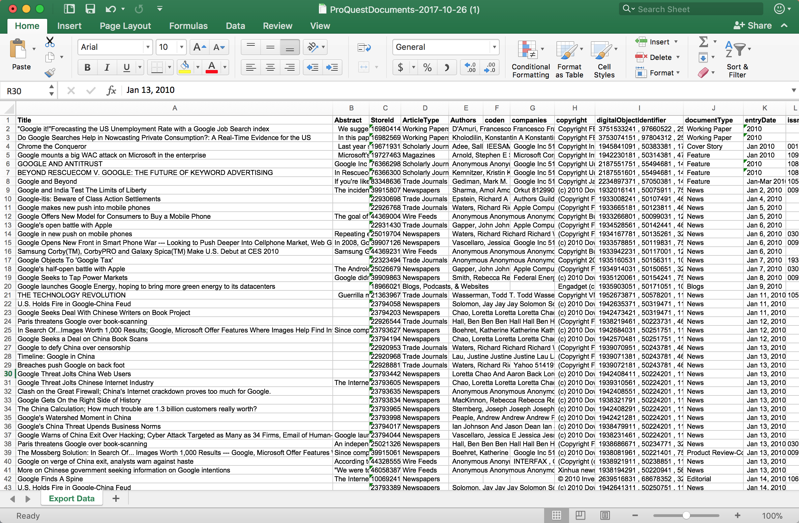

Slide 20
Columns
Title
Publish date
……
……
Authors
Abstract

Slide 21
Challenges and open questions
Key challenges: Improve the accuracy
Feature Extractions
Positive polarity of the words should be recognized.
Historical Information
historical information of the stock price should be taken into consideration.
Model Testing
We will consider the policy related to a single stock into our model since its influences are enormous.

Slide 22
THANK YOU!

